Slide 1
The Effects of Prosocial Tendencies on Interpersonal and Personal Interactions
Hannah Spilhaus

Slide 2
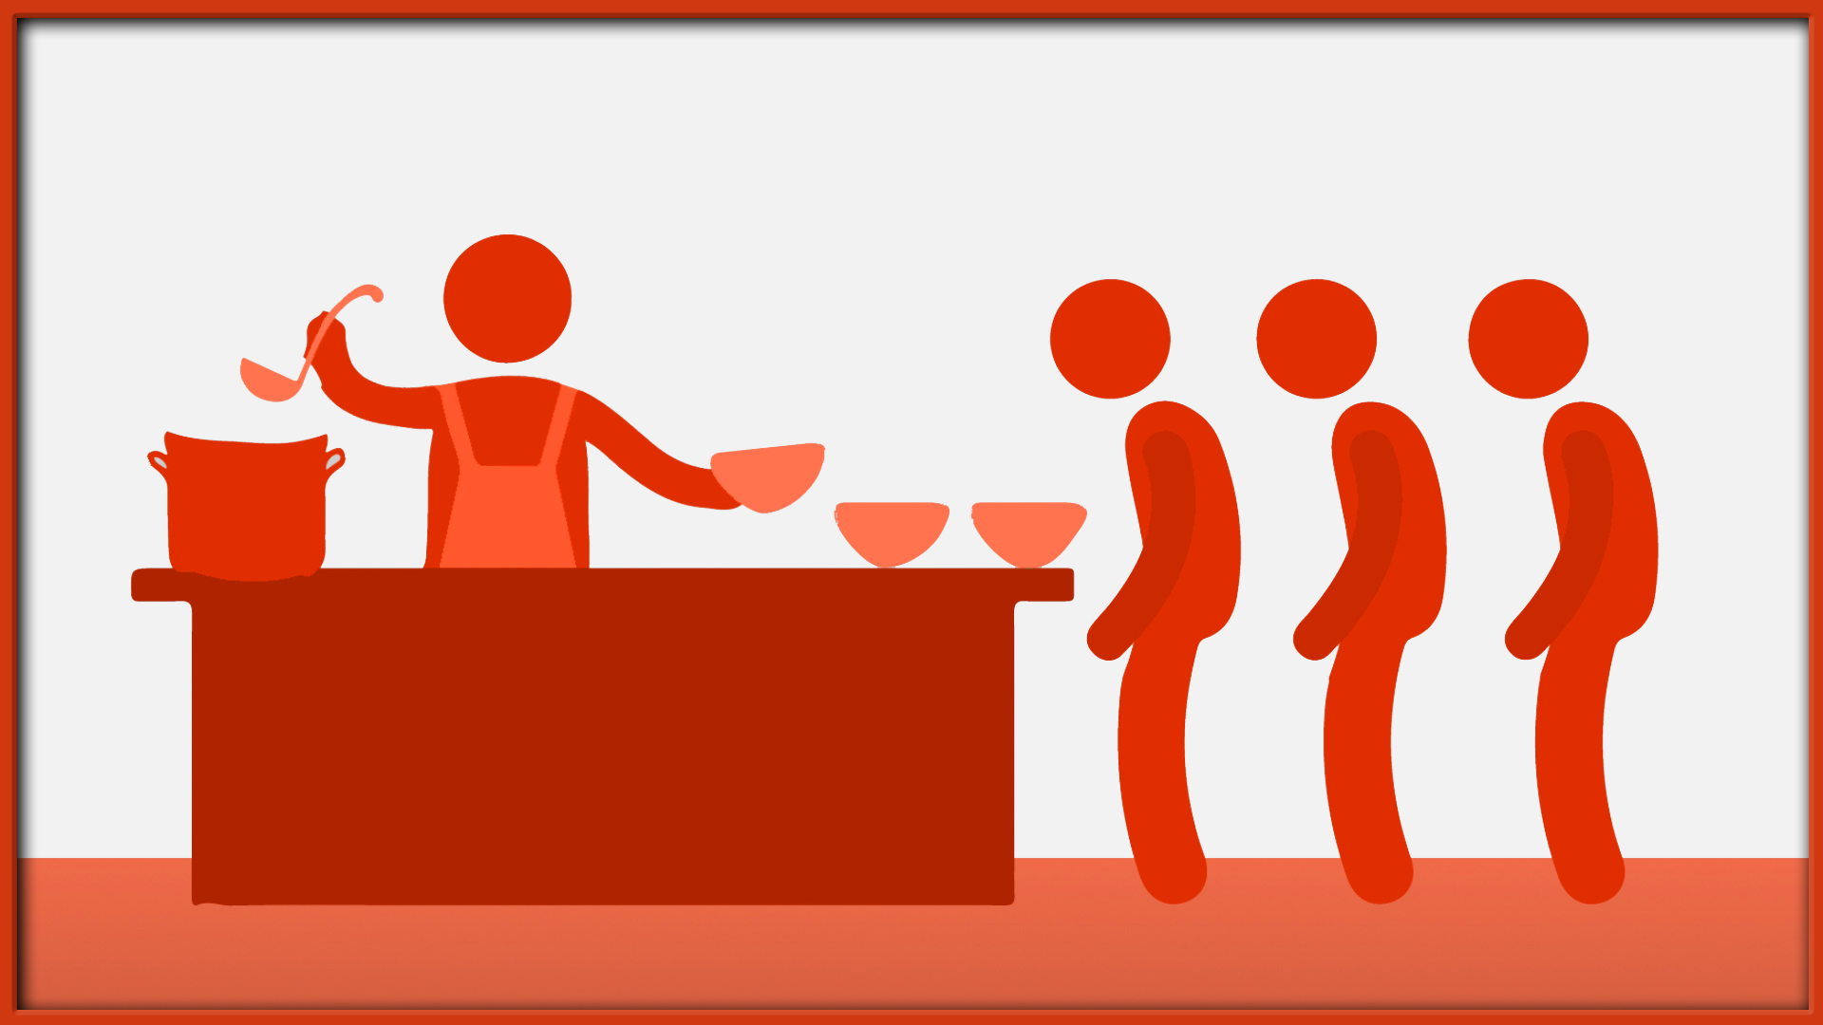
Introduction
What is prosocial behavior?
Voluntary behaviors intended to benefit another individual.
Ex: helping, sharing and providing comfort
Applicable in
interpersonal relationships
interactions among individuals/groups without close ties
Notes:
interpersonal - how peers interact , relationships
Groups without close ties- peers in schools, co-workers,

Slide 3
Introduction
Prosocial behavior in society
Present in many different aspects of society such as
Social standards
Political standards
Essential in understanding what leads a person to make a decision.
Prosociality is characterized by behaviors that will benefit another person but not yourself
Notes:
Social standards- stealing is bad, call 911 and community service
Political service- jury duty, volunteering at the polls
Decision making_ altruistic or selfish
It is also essential in understanding what leads a person to make a decision, especially ones that will affect another person
For example, if you were to witness a car accident that you're involved with in any way, and after witnessing the accident, you call 911. This decision to call 911 and help the people in the accident is a prosocial act. There is no direct benefit for yourself after doing this act. Calling 911, and helping those people will probably cause you to feel a drawback emotion such as happiness. This feeling of happiness causes you to want to seek it over and over again, almost as if prosocial behaviors are addicting; but it can also cause you to feel like you have fulfilled the quota for good behaviors for that time being.
Meaning there can be no direct result to how that help you provided to another will actually affect yourself.

Slide 4
Review of Literature
There is a framework that suggested that moral behaviors can result from an internal balancing act of good and bad behavior.
Sachdeva, S., Iliev, R., & Medin, D. L. (2009). Sinning Saints and Saintly Sinners: The Paradox of Moral Self-Regulation. Psychological Science, 20(4), 523–528. https://doi.org/10.1111/j.1467-9280.2009.02326.xwww.jstor.org/stable/25482392.
Notes:
this means that once you have conducted this prosocial act, such as calling 911, you feel as if you don't need to uphold the standards in other areas
That you have balanced your behaviors internally.
This is relevant to the research we are conducting because this so-called balancing act of moral behaviors can affect a person's willingness to help another individual.

Slide 5
Review of Literature
People are more willing to help when they have persistently experienced good moral behavior, moral behavior is controlled by a negative feedback mechanism
ie: “treat people the way you want to be treated”
Daryl C, C., Payne, K. B . (2012). “The Cost of Callousness: Regulating Compassion Influences the Moral Self-Concept.” Psychological Science, vol. 23, no. 3, pp. 225–229., www.jstor.org/stable/41441777.
Notes:
This is very similar to the idea that we have all been raised with, “treat people the way you want to be treated.” If you are treated in a bad way after you have only been nice to someone, your desire to help that individual will decrease.

Slide 6
Review of Literature
Moral behaviors are controlled by a self- regulated process that creates a “damage control” response in social situations.
Conway, P., Peetz, J. (2012).“When Does Feeling Moral Actually Make You a Better Person? Conceptual Abstraction Moderates Whether Past Moral Deeds Motivate Consistency or Compensatory Behavior.” Personality and Social Psychology Bulletin,
Notes:
As to prevent negative outbursts of behaviors, this damage control response makes a person subconsciously question an interaction, whether it was a positive or negative one and helps to make a decision on how to advance in that situation and whether or not to engage in an act of prosociality.

Slide 7
Review of Literature
There are different directions prosocial behavior can extend.
Paying it back
Paying it forward
Geher , G. (2014). “How We've Evolved to Pay It Back and Pay It Forward.” Psychology Today, Sussex Publishers,www.psychologytoday.com/us/blog/darwins-subterranean-world/201407/how-weve-evolved-pay-it-back-and-pay-it-forward.
Notes:
paying it back: giving to others who have done something that shows altruistic behavior to you, for example helping your friend with math homework after they have helped you with science homework.
paying it forward: completing an altruistic act without having someone do something nice first, for example calling 911 after witnessing a car accident

Slide 8
Hypothesis
Individuals are more likely to help a target individual who has demonstrated to be helpful in the past

Slide 9
Methodology
Methodology was based off of a study on the evidence of codependency in women with an alcoholic parent
study conceptualized codependency and its development among women being raised in an environment of an alcoholic parent.
proposed that women who are used to conforming to the demands of an expolistive person would be more likely to help an experimenter portrayed as exploitative

Slide 10
Methodology
Demographics
Between-groups design on adolescents from NPHS school between the ages of 13-18
Sample size of 133 participants, freshman to seniors
Advanced and regular placement classes

Slide 11
Methodology
Participants were randomly chosen and assigned to one of two conditions.
Positive condition and negative condition
Both conditions:
included vignettes about a target person whom they had the option of helping with a homework related task
vignettes described an interaction with “Paul” who helped someone with a homework related task
then explained how “Paul” was looking for help.

Slide 12
Vignette (positive): 0
I know this guy named Paul, he is about 5’11’’ and has short brown hair, brown eyes and wears glasses. His favorite sport is baseball and he knows how to play the guitar. Paul is a really good student, he likes math and science. He also has a younger brother and an older sister, every year his family goes on a trip to the beach for a week. This year Paul said he wants to learn to surf. Last year Paul helped me with a project for school. He was super helpful. He always came excited to work and was super encouraging and supportive. I got a really good grade on the project because of his help and positive attitude.
Paul is doing a project for school now and needs help. He asked me to help him gather data. Please answer the following questions for Paul's project.
Vignette (negative): 1
I know this guy named Paul, he is about 5’11’’ and has short brown hair, brown eyes and wears glasses. His favorite sport is baseball and he knows how to play the guitar. Paul is a really good student, he likes math and science. He also has a younger brother and an older sister, every year his family goes on a trip to the beach for a week. This year paul said he wants to learn to surf. Last year Paul helped me with a project for school. He was super unhelpful. He would show up with a really bad attitude and act as if it was the last place he wanted to be. He would continuously put down my work and make me feel bad about my project. I got a really bad grade on the project because of his lack of help and attitude.
Paul is doing a project for school now and needs help. He asked me to help him gather data. Please answer the following questions for Paul's project.
Notes:
started by describing Paul and his interests,
then described how he helped another individual then proceeded to explain why he needed the participants' help.
The first vignette portrayed Paul as a helpful, kind person.
key phrases like, “he was super helpful”, “because of him I got a good grade”, “had a positive attitude and was supportive”.
The second vignette portrayed “Paul” as an unhelpful, unapproachable person.
key phrases “he was super unhelpful”, “really bad attitude and morale”, “put down my work and made me feel bad”, “got a bad grade because of him”.
Based on Paul's interaction with the other individual explained in the vignette the participants had to answer a series of questions

Slide 13
Survey
AGE:_____________________
GENDER(circle one): M F OTHER
RELIGION(if comfortable):__________________________________________________
PARENTS MARITAL STATUS(if you are comfortable answering):
Together separated
How much time are you willing to give to Paul (in minutes): CIRCLE ONE
0 5 10 15 20 25 30 35 40 45 50 55 60 65 70 75 80 85 90 95 100 105 110 115 120 140 160 180
Why are you willing to donate that amount of time:________________________________
___________________________________________________________________________________________________________________________________________________________________________________________________________________________________________
Notes:
The questions consisted of participants' age, gender, religiosity, religion, parents’ marital status, how much the participant was willing to donate to Paul (in minutes) and a short description of why they chose that amount of time.
Main variable tested was the amount of time that participants were willing to donate
Expected primary outcome variable would pertain to how much the participants were willing to volunteer to help Paul with some homework-related task.
Anticipated that more people would be willing to donate more time to the version of Paul who is portrayed in a positive manner.

Slide 14
Results
Gender | Paul | Mean | Std. Deviation | N
Male | Positive reputation | 67.2308 | 45.91759 | 26
 | Negative reputation | 23.1000 | 31.02029 | 30
 | Total | 43.5893 | 44.26029 | 56
Female | Positive reputation | 79.5714 | 57.38635 | 35
 | Negative reputation | 38.8537 | 40.51269 | 41
 | Total | 57.6053 | 52.77931 | 76
Total | Positive reputation | 74.3115 | 52.74958 | 61
 | Negative reputation | 32.5833 | 37.26938 | 72
 | Total | 51.7218 | 49.47227 | 133
Significant main effect for the reputation of Paul (F(1, 128) = 618.040, p = .026).
There was also a significant main effect for gender of participant (F(1, 128) = 3.512, p = .033).
Table 1: The Reputation of Paul's Effect on Gender
Notes:
primary analysis- two-way analysis of Variance using helping (in terms of minutes allocated) as the dependent variable and with Paul’s reputation (positive or negative light) and gender as the independent variables.
People were more likely to want to help the “good” Paul than the “bad” Paul.
gender - this effect was driven by the fact that on average, women were more helpful than men.

Slide 15
Results
A correlation was run between degree of religiosity and proclivity to help
result yielded a significant finding (r(153) = .15, p = .04)
There were no significant effects for age or parents marital status on the amount of time willing to donate to Paul.
Notes:
People who identified as more religious were generally more helpful, regardless of the experimental conditions that they were in.
Ages effect on helping was trending towards significant but it was not statically significant enough to be a trend.
No data was significant enough to show that parents marital status correlated to rates of prosociality.

Slide 16
Discussion
Prosocial behaviors tend to be exerted when an individual feels like they were treated well in return
The participants who received the positive reputation of Paul felt obligated to help him with some homework related task, but the participants who received the negative reputation Paul didn't feel obligated to help him.
The hypothesis was supported by the results of the experiment.
The effect of prosociality on interpersonal and personal relationships, even those of a virtuous fashion are extremely prominent in how a person will react and the levels of prosocial behaviors that will be exerted.
Notes:
But why? Conway and Peetz’s (2012) theory of moral behavior being controlled by a negative feedback mechanism illuminates the subconscious want to help people based on how individuals are treated, negatively or positively.
This mechanism will subconsciously prevent a person from interacting with that negatively behaved individual as much as they can in the future. It creates a damage control response to protect themself from getting hurt

Slide 17
Discussion
Evidence supports that prosocial behavior and religion having effects on each other
much evidence to support that prosocial behavior and religion have an effect on each other it is very hard to say which is affecting the other.
On average women were more helpful than men.
consistent with other research conducted in the field.
Notes:
Women and men tend to observe different social norms around the world, and depending on the contexts of situations different behaviors are expected from the different genders.

Slide 18
Conclusion
The effect of prosociality, even those of a virtuous fashion, are extremely prominent in how a person will react and the levels of prosocial behaviors that will be exerted.

Slide 19
Future Work
Examine the effects and influences of prosocial behaviors on religion and gender.

Slide 20
Works Cited
Ahmed, A. (2009). Are Religious People More Prosocial? A Quasi-Experimental Study with "Madrasah" Pupils in a Rural Community in India. Journal for the Scientific Study of Religion, 48(2), 368-374. http://www.jstor.org/stable/40405622
Bell, C. M., Hughes-Jones, J. (2008). “Power, Self-Regulation and the Moralization of Behavior.” Journal of Business Ethics, vol. 83, no. 3, pp. 503–514. JSTOR, JSTOR, www.jstor.org/stable/25482392.
Daryl C, C., Payne, K. B . (2012). “The Cost of Callousness: Regulating Compassion Influences the Moral Self-Concept.” Psychological Science, vol. 23, no. 3, pp. 225–229., www.jstor.org/stable/41441777.
Coeckelbergh, M. (2006). “Regulation or Responsibility? Autonomy, Moral Imagination, and Engineering.” Science, Technology, & Human Values, vol. 31, no. 3, pp. 237–260. JSTOR, JSTOR, www.jstor.org/stable/29733939.
Conway, P., Peetz, J. (2012).“When Does Feeling Moral Actually Make You a Better Person? Conceptual Abstraction Moderates Whether Past Moral Deeds Motivate Consistency or Compensatory Behavior.” Personality and Social Psychology Bulletin, vol. 38, no. 7, pp. 907–919, doi:10.1177/0146167212442394
Jonas, D. (2019). “How Do We Decide Whether or Not to Help Others-On Prosocial Behavior.” Psychology Today, www.psychologytoday.com/us/blog/human-decision-making/201912/how-do-we-decide-whether-or-not-help-others.
Espinosa, M. P., Jaromír, K.(2015). “Prosocial Behavior and Gender .” Frontiers in Behavioral Neuroscience.
Geher , G. (2014). “How We've Evolved to Pay It Back and Pay It Forward.” Psychology Today, Sussex Publishers,
www.psychologytoday.com/us/blog/darwins-subterranean-world/201407/how-weve-evolved-pay-it-back-and-pay-it-forward.
Joosten, A., van Dijke, M., Van Hiel, A. et al. J Bus Ethics (2014) 123: 71. https://doi.org/10.1007/s10551-013-1794-z
Deborah, L., Greenberg, J. (1991). “Evidence of Codependency in Women With an Alcoholic Parent: Helping Out Mr. Wrong.” Journal of Personality and Social Psychology , vol. 16, no. 3, ser. 435-439.
Matsumoto, Y., Yamagishi, T., Li, Y., & Kiyonari, T. (2016). Prosocial Behavior Increases with Age across Five Economic Games. PloS one, 11(7), e0158671.https://doi.org/10.1371/journal.pone.0158671
Psychology. (n.d.). Retrieved from http://psychology.iresearchnet.com/social-psychology/social-psychology-topics/prosocial-behavior-research-topics/.
Sachdeva, S., Iliev, R., & Medin, D. L. (2009). Sinning Saints and Saintly Sinners: The Paradox of Moral Self-Regulation. Psychological Science, 20(4), 523–528. https://doi.org/10.1111/j.1467-9280.2009.02326.xwww.jstor.org/stable/25482392.
Zhong, C.B., Liljenquist, K., & Cain, D. M. (2009). Moral self-regulation: Licensing and compensation. In D. De Cremer (Ed.), Psychological perspectives on ethical behavior and decision making (pp. 75-89). Charlotte, NC, US: Information Age Publishi

